Slide 1
Apply functions in r
IST 719
SPRING 17
Pan Chen

Slide 2
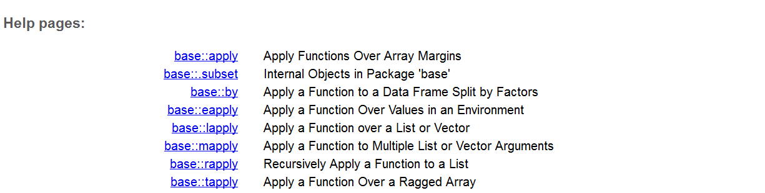
Apply: what are these functions in R?
They apply functions to manipulate slices of data. Their results can be use useful for the visualization
With these apply functions we can avoid looping, and write code that is meaningful in a statistical setting.

Slide 3
apply(X, MARGIN, FUN, ...)
Applies to every column and/or every row in a matrix or an array
X: an array or a matrix, MARGIN value could be 1, 2 or c(1,2). 1 means applies to every row, 2 means apply to every column, and c(1,2) means apply to every row and column.
FUN: the function we want to apply ( mean, max, median, sum, etc..or your own function)
Returns a vector

Slide 4
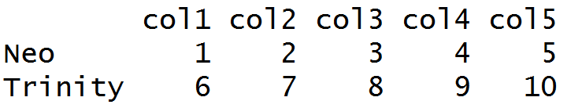
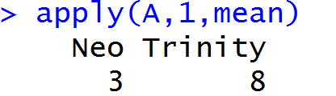
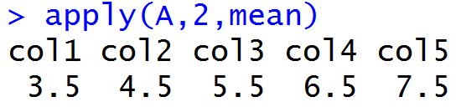
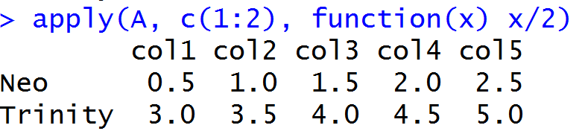
apply(X, MARGIN, FUN, ...)
Returns a vector

Slide 5
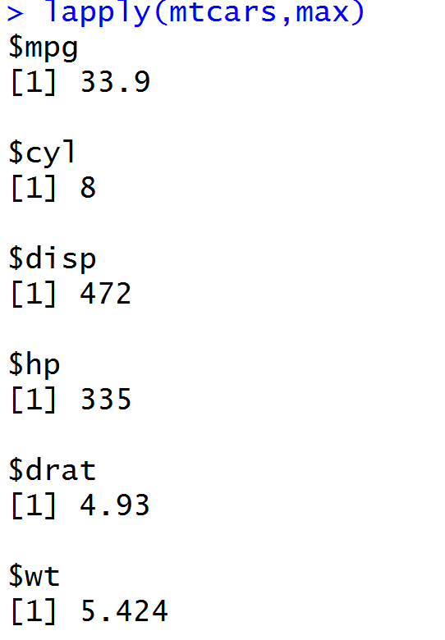
lapply (x,fun…) sapply (X,fun…)
Apply function to list element(s) in a list or column(s) in a dataframe
X: the list or vector(s) you want to apply a function on
The difference: lapply returns a list, sapply returns a vector.

Slide 6
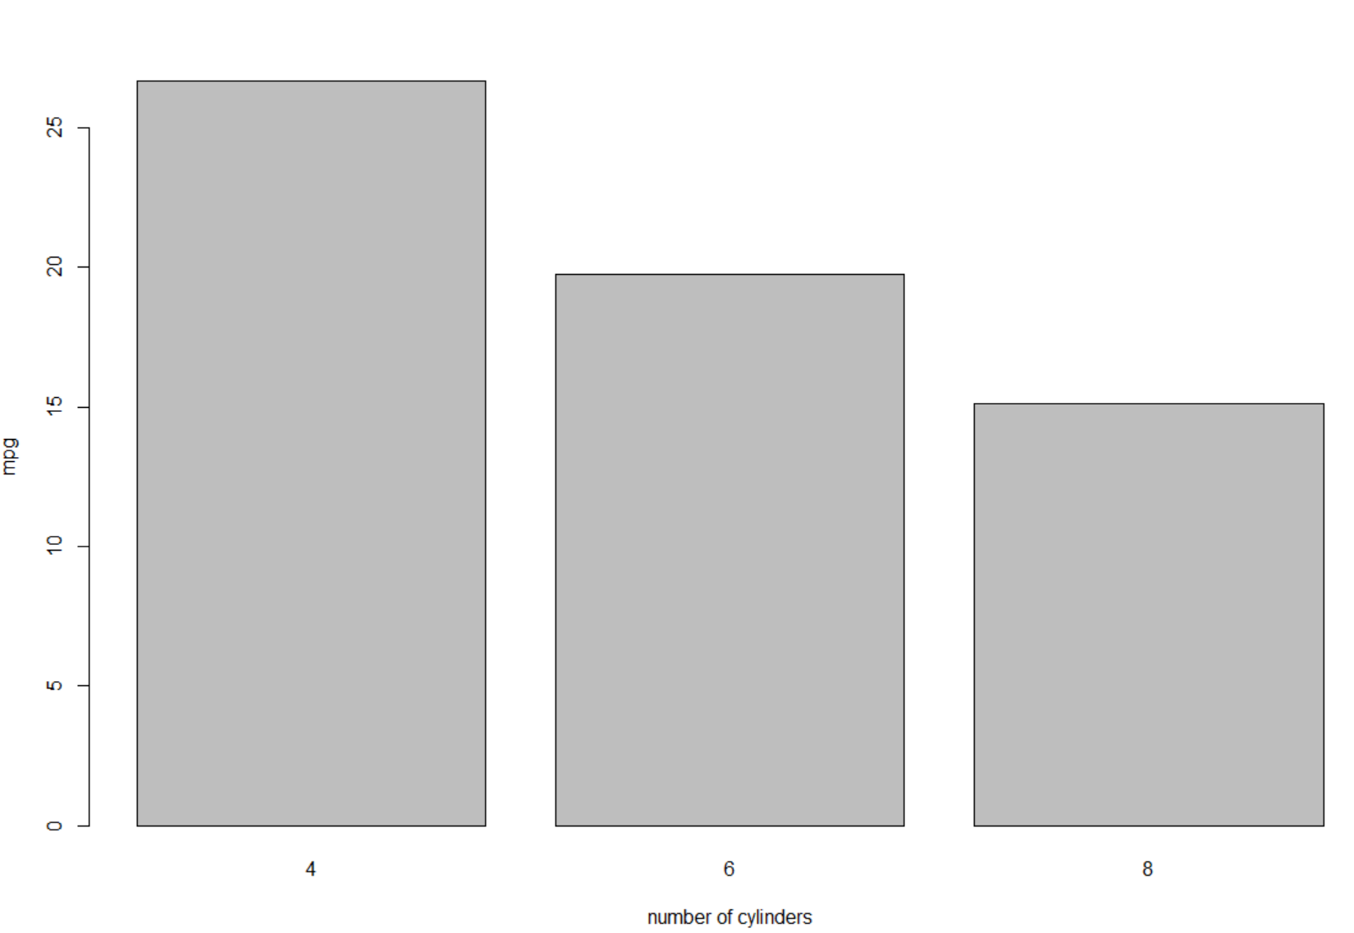
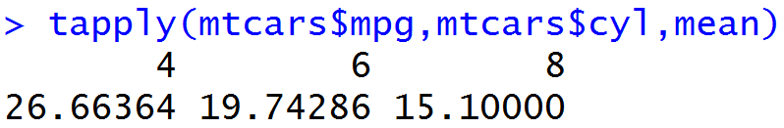
tapply(x,INDEX,fun…)
Apply a function on subset of the vector broken down by a given factor variable.
X: usually a vector, INDEX: a list of grouping factors, each of same length as X
Useful for plotting comparisons by groups
Apply MEAN to mpg GROUP BY cyl and return an array

Slide 7
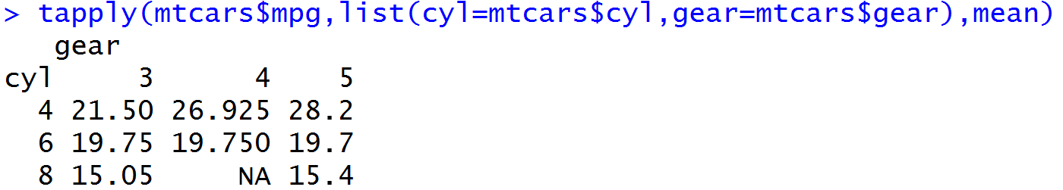
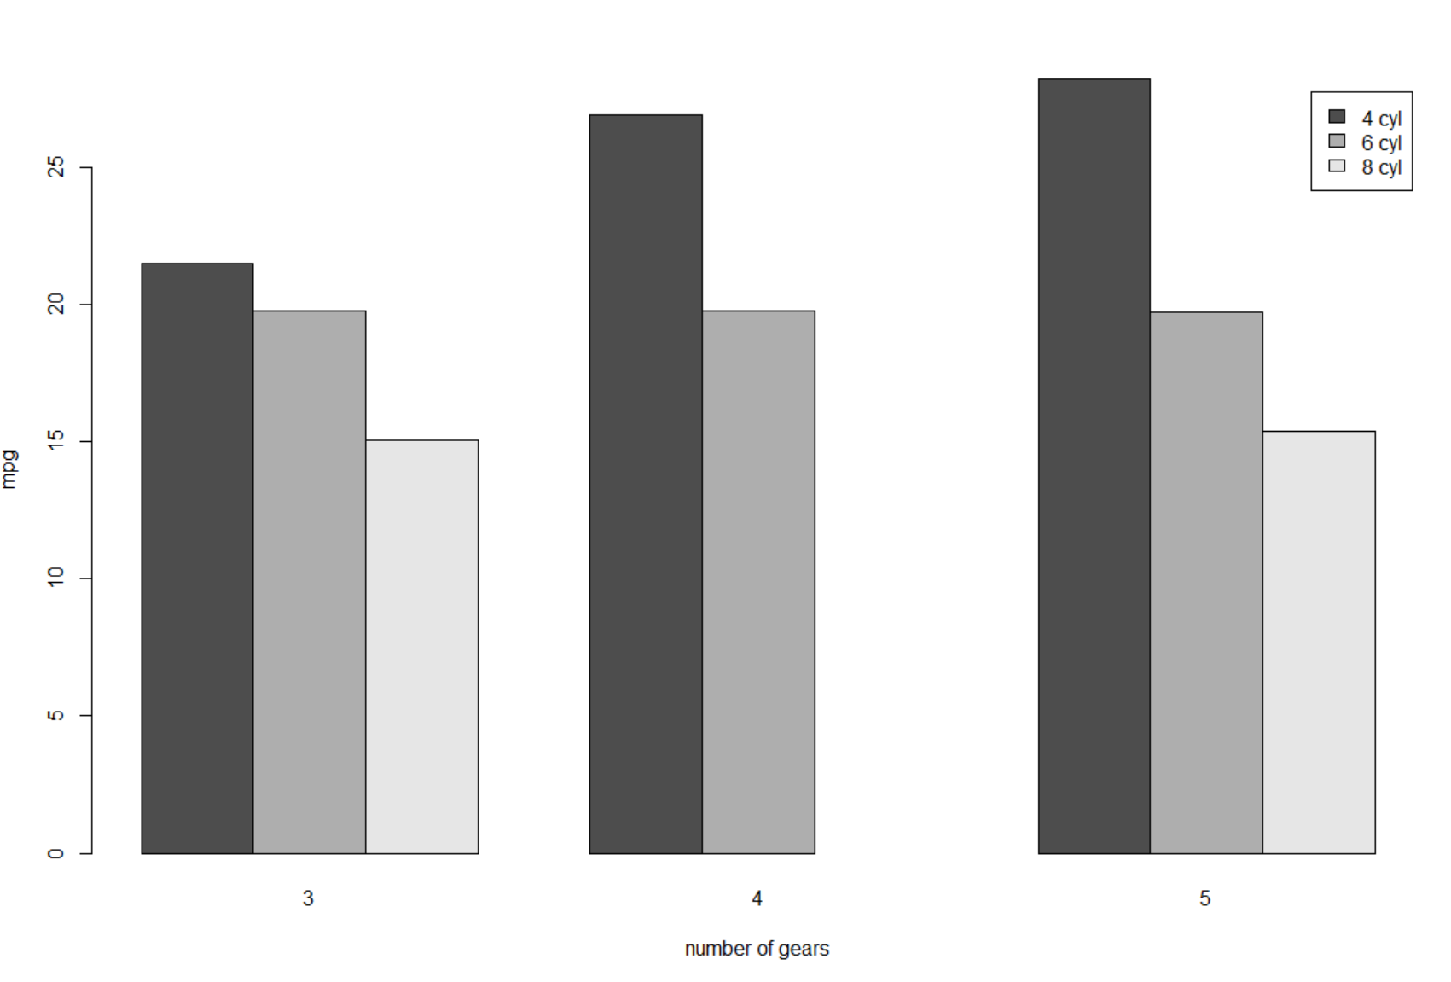
tapply(x,INDEX,fun…)
Apply mean to mpg column group by cyl and gear and return a matrix
With cyl as rows and gear as columns

Slide 8
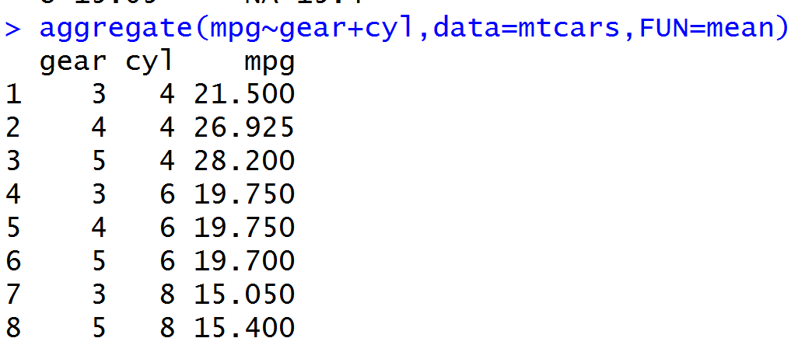
tapply() vs aggregate()
Both are able to apply function
to subsets of data
tapply:
Return a matrix or array
Aggregate:
Return a data frame with one row for
each category

Slide 9
Thank you!!!
Pan Chen

